Slide 1
Strongly Connected Components
By – Amish Gadhia, Parth Sonagara

Slide 2
Objective
Our objective in this project is to find the Strongly Connected Components in a graph by comparing two algorithms Kosaraju and Tarjan.
We choose this project because we are inspired by the social media network called Facebook the way how it suggests friends based on similar interests.
Although both of these algorithms have same asymptotical run time i.e. O (V+E), but we found that there are some constant factors which makes Tarjan’s algorithm optimal.

Slide 3
Applications
Target audience for advertisement
To find the audience based on similar interests and advertise them the products.
Vehicle Routing
If UPS truck has to deliver packages at a certain places in a town. Then through SCC we can find that which packages can be delivered fast.
Social Media Network
To recommend friends or contents based on similar interests.

Slide 4
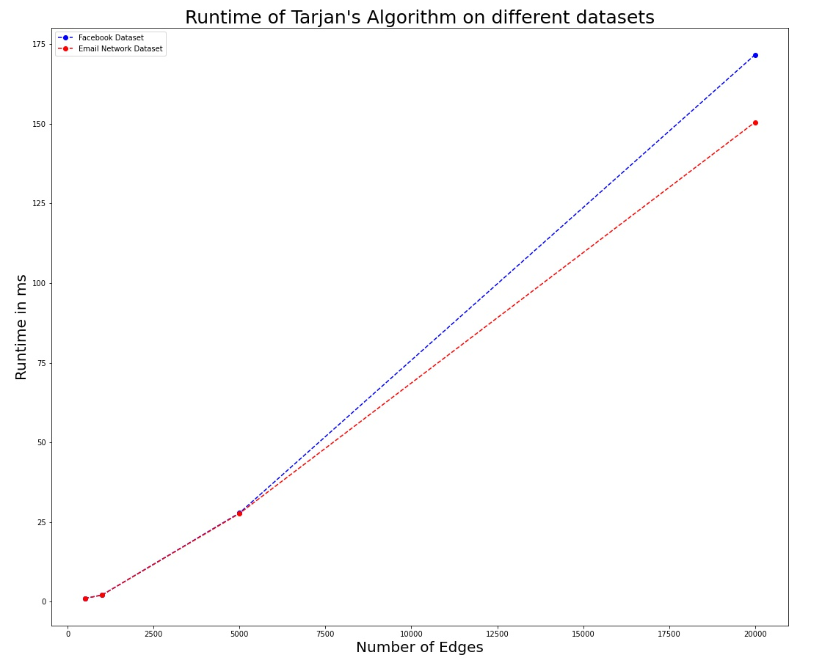
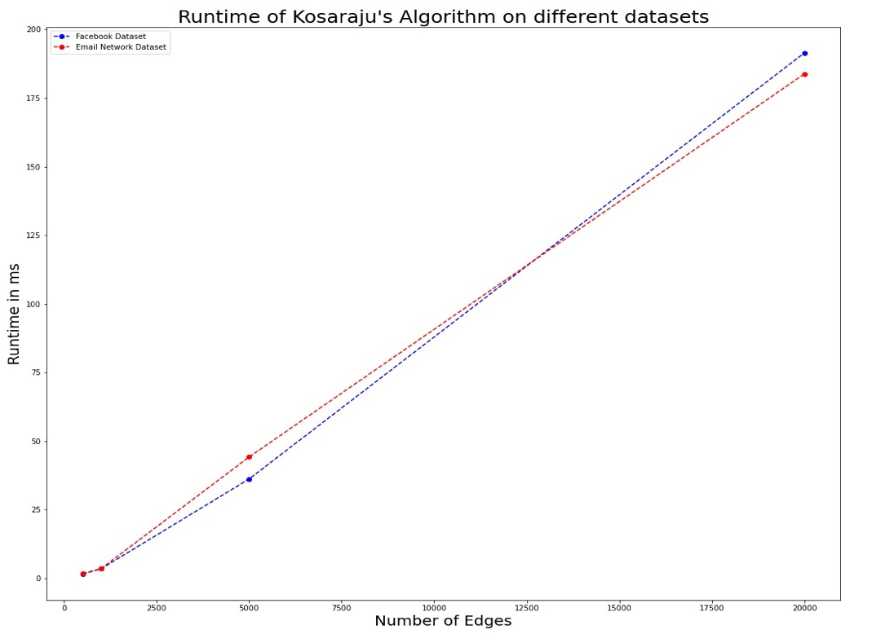
Algorithms on different datasets

Slide 5
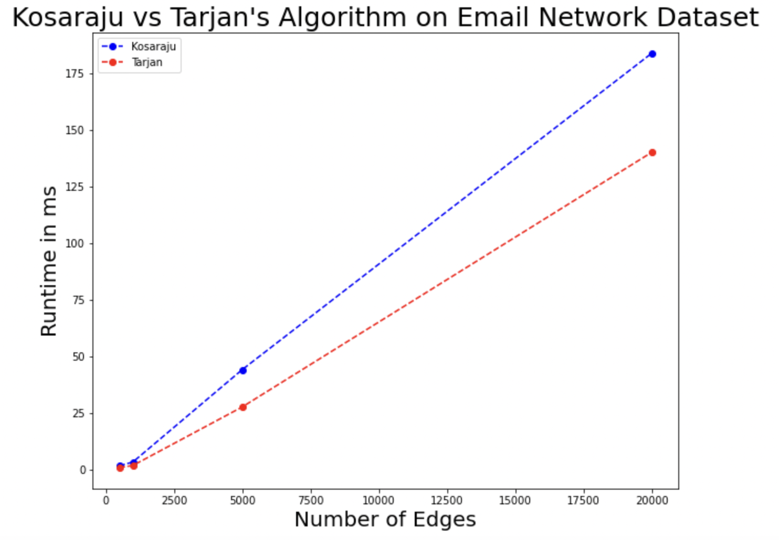
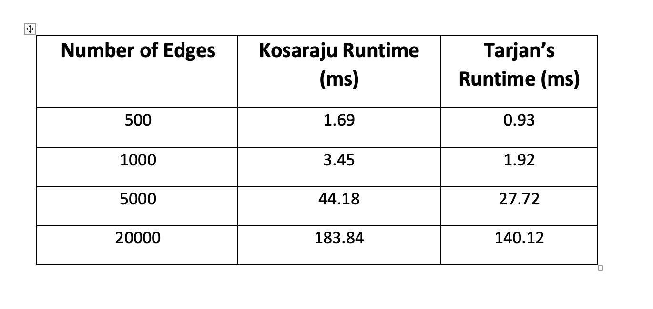
Results of Email Network Dataset

Slide 6
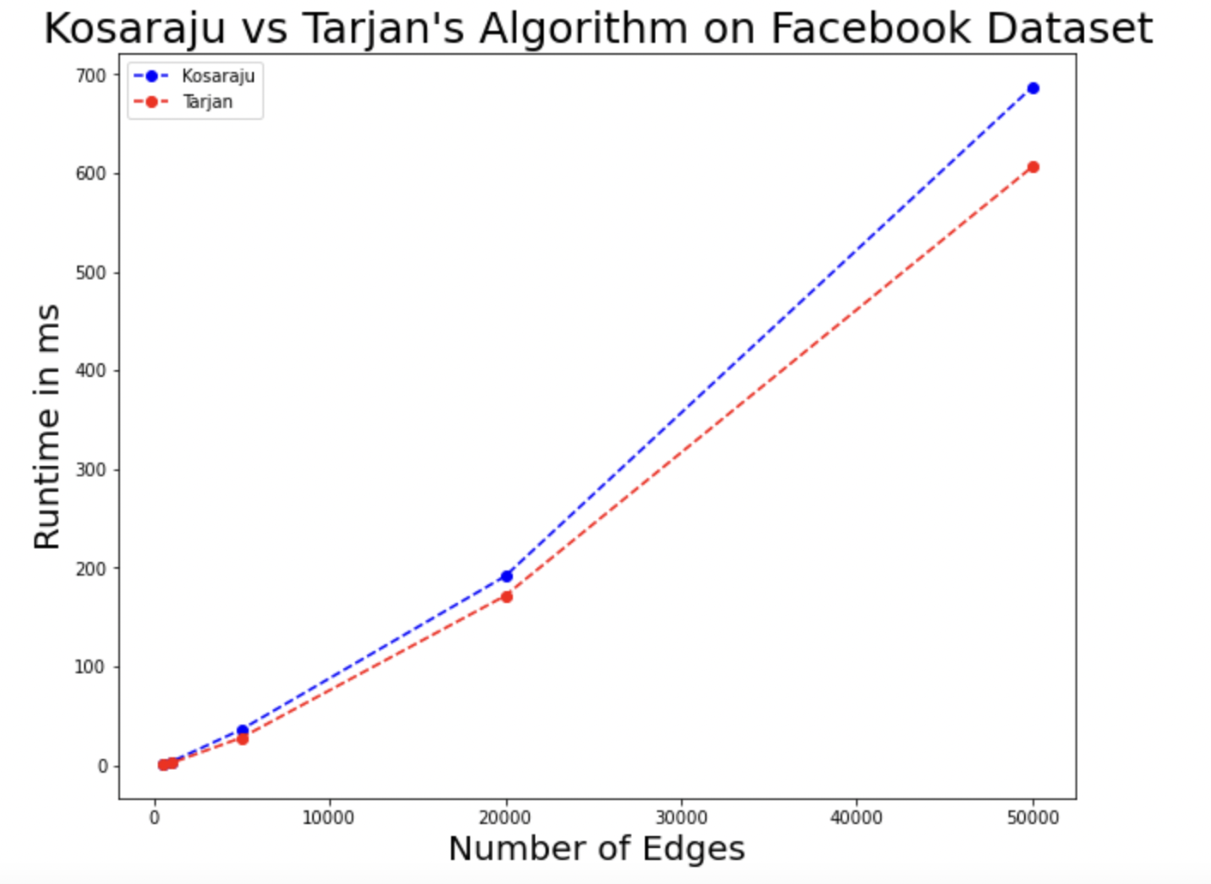
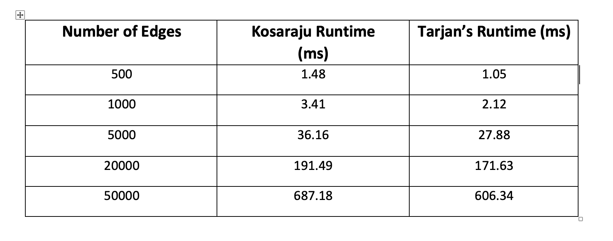
Results of Facebook Dataset

Slide 7
Conclusion
After comparing both these algorithms on the real time dataset we conclude that, the Tarjan algorithm is about 150% faster than the Kosaraju algorithm.
So, Tarjan is way faster and more optimal than Kosaraju based on our comparison.
The Kosaraju algorithm does not deviate more as compared to the Tarjan’s algorithm on the different datasets.

